Slide 1
Analysis of Discrete-Time Systems
Linear difference equations
  Solving linear constant coefficient difference equations
Z-transform
  Properties
Inverse Z-transform
  Long-division
  Partial fraction expansion
  Inverse Z-transform integral

Slide 2
Linear Difference Equations
Consider treatment of signals inside a digital computer
Suppose output at time k depends on input signal up to time k and output signal up to time k - 1.
If linear, and assume dependence on finite number of past input and output values
Linear constant difference equation

Slide 3
Solving Linear Constant Coefficient Difference Equations
Given equation and initial conditions (I.C.s), how do we solve?
Consider difference equation approximation to compute integral:
Assume have approximation for integral from time 0 to time (k - 1)T

Slide 4
Approximate area under curve over each interval using a trapezoid.
Area of trapezoid
Recursive formula/solution

Slide 5
Example
e(t ) = t
Suppose
What is u_{k} ?

Slide 6
In this case, u_{k} is the exact integral since each trapezoid is the exact area of each increment.
In this case, not too difficult to solve for u_{k} absolutely.
In general, more difficult though . . .
Often easier to solve by Z-transform.
Similar to solving linear constant coefficient ordinary differential equations using Laplace transforms.

Slide 7
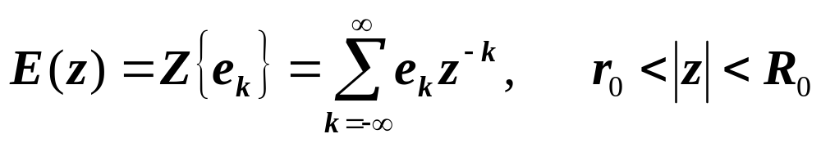
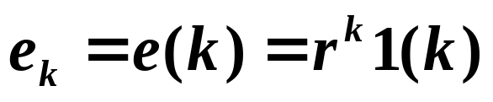
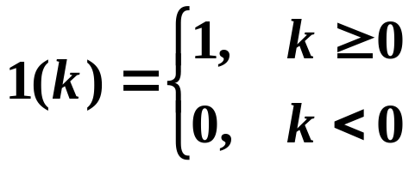
Z-Transform
If a signal has discrete values e₀ , e₁ , . . . , e_{k} , . . . , the Z-transform of the signal is
where r₀ and R₀ are bounds on |z| such that the series converges.
Im(z)
Re(z)
Im(z)
Re(z)
Example:
where is the unit step function.

Slide 8


Examples of
Im(z)
Re(z)
1
Im(z)
Re(z)
1
Im(z)
Re(z)
1

Slide 9
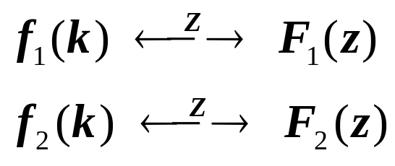
Properties of the Z-Transform
Linearity
If
and
then

Slide 10
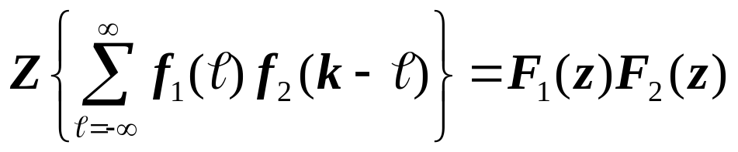
Convolution of time sequences
If
and
then

Slide 11
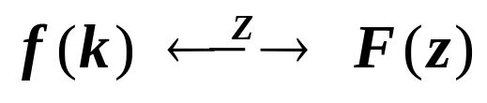

Time shift
If
then for any integer n.

Slide 12





Page <number>
If G(s) is time invariant, is a sampled-data system with G(s) time-invariant?

Slide 13

Im(z)
Scaling in the z-plane
If
then
Re(z)
1

Slide 14
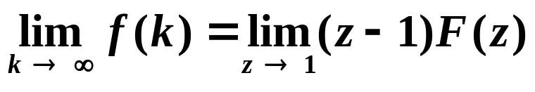
Final Value Theorem
If F(z) converges for |z|>1 and all poles of (z - 1)F(z) are inside the unit circle, then
Conditions on F(z) ➔ only pole not strictly inside the unit circle is a simple pole at z = 1, which is removed in (z - 1)F(z).
The fact that F(z) converges as the magnitude of z gets arbitrarily large ensures that f(k)=0 for k<0.
All components of f(k) → 0 as k → infinity, with the possible exception of a constant term due to a pole at z = 1.

Slide 15
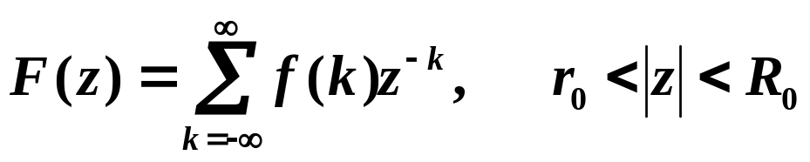
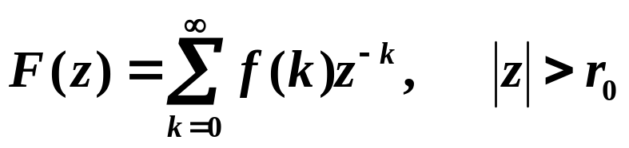
Inverse Z-Transform
Given the Z-transform F(z), how do we compute the sequence f(k) that F(z) is the Z-transform of?
Two-sided Z-Transform:
Im(z)
In this course, we will mainly be concerned with one-sided Z-Transforms:
Re(z)
1

Slide 16
Can find inverse Z-transform by a number of techniques:
  Long-division
  Partial fraction expansion
  Inverse Z-transform integral
Long-division
  If F(z) is a ratio of polynomials in z ⁻¹, perform long-division of the numerator by the denominator. In the result, the coefficient of z ^{-k} is the sequence value f(k).
  Example

Slide 17
Partial fraction expansion
  Compute and tabulate F(z) for several basic f(k)’s.
  Then when given a new F(z), decompose F(z) by partial fraction expansion and look-up the components of the sequence f(k) in the previously prepared table.

Slide 18
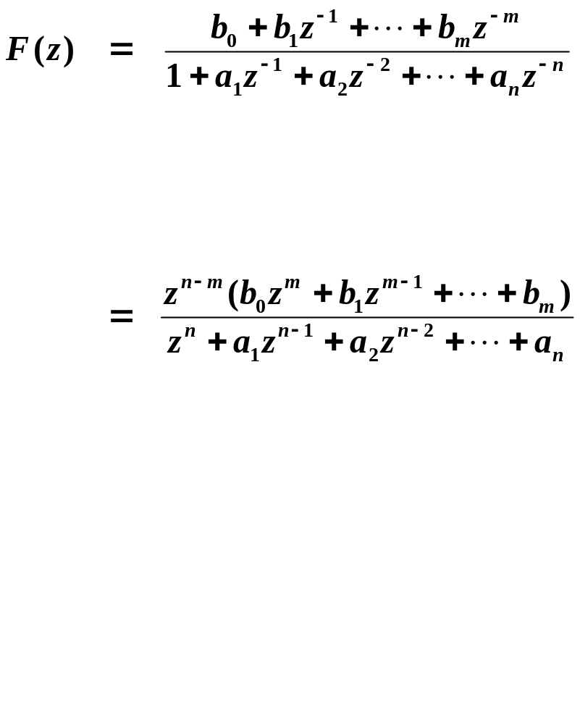
In general:

Slide 19

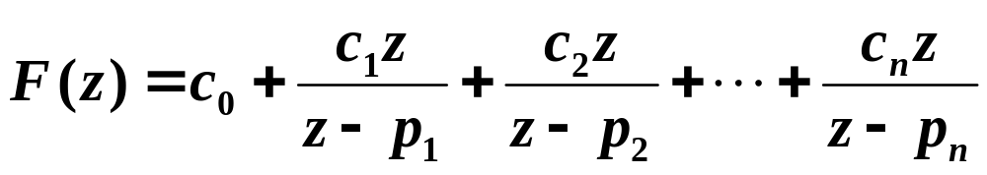
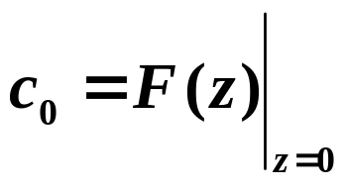
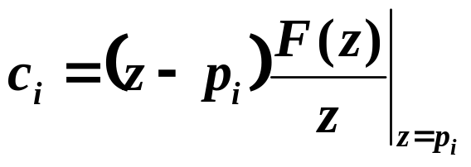
  Assuming all poles are distinct and
where and

Slide 20
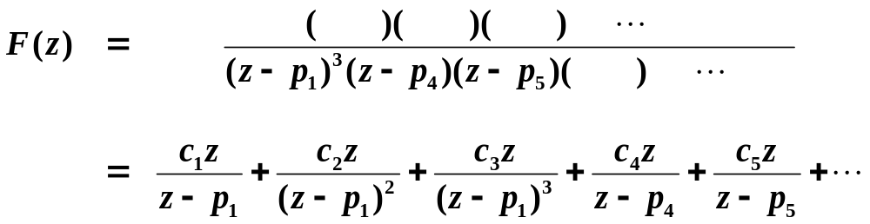
  If there are repeated poles:
Suppose p₁ is repeated 3 times:

Slide 21

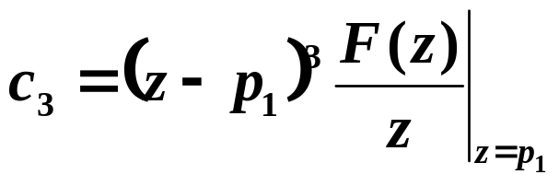
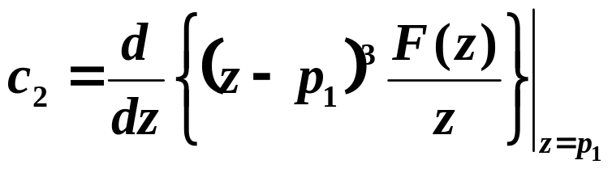
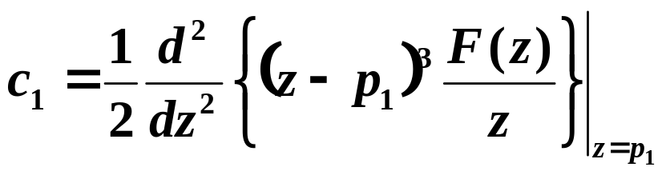
where
for
(distinct poles)

Slide 22

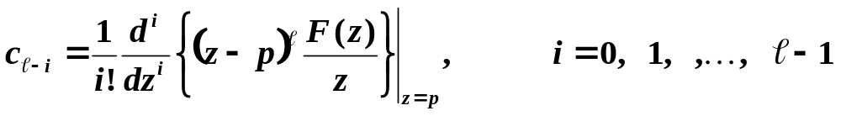
In general, if a pole p has multiplicity , then
are the coefficients associated with the pole p.

Slide 23
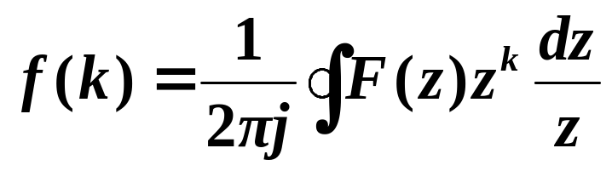
Inverse Z-transform integral
Im(z)
is the closed, complex integral:
where the contour is a circle in the region of convergence of F(z).
We will primarily use Partial Fraction Expansions in this course.
Re(z)

